Slide 1

RUNGTA COLLEGE OF DENTAL SCIENCES & RESEARCH
TITLE OF THE TOPIC
DENTAL CARIES
DEPARTMENT OF ORAL PATHOLOGY & MICROBIOLOGY

Slide 2
DENTAL CARIES
GUIDED BY :-
DR. SIDDHARTH PUNDIR
DR. SUDHANSHU DIXIT

Slide 3
Specific learning Objectives
Core areas* | Domain ** | Category #
DEFINITION | CONGNITIVE | MUST KNOW
CLASSIFICATION | CONGNITIVE | MUST KNOW
THEORIES OF DENTAL CARIES | CONGNITIVE | MUST KNOW
ZONES OF BACTERIAL INFECTIONS | CONGNITIVE | MUST KNOW

Slide 4
Table of Content
DEFINITION
CLASSIFICATION
THEORIES OF DENTAL CARIES
ZONES OF BACTERIAL INFECTIONS

Slide 5
DEFINITION
According to Shafer's , Dental caries is defined as :- an irreversible microbial disease of the calcified tissues of the teeth, characterized by demineralization of the inorganic portion and destruction of the organic substance of the tooth, which often leads to cavitations.

Slide 6
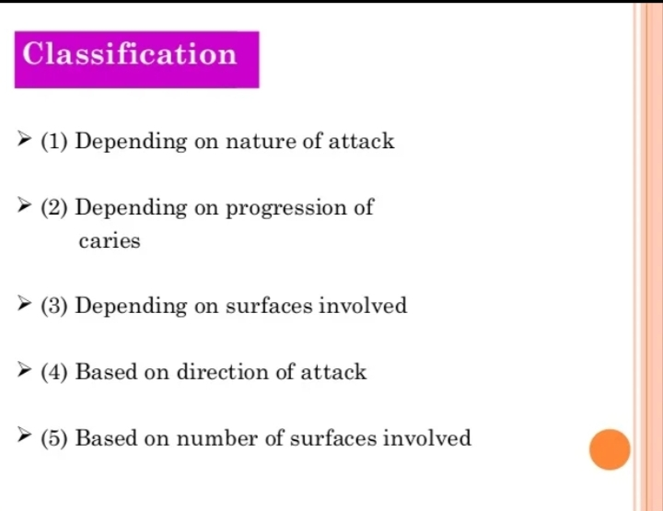

Slide 7
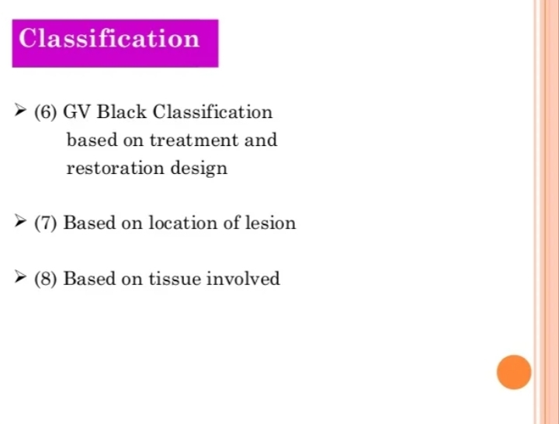

Slide 8
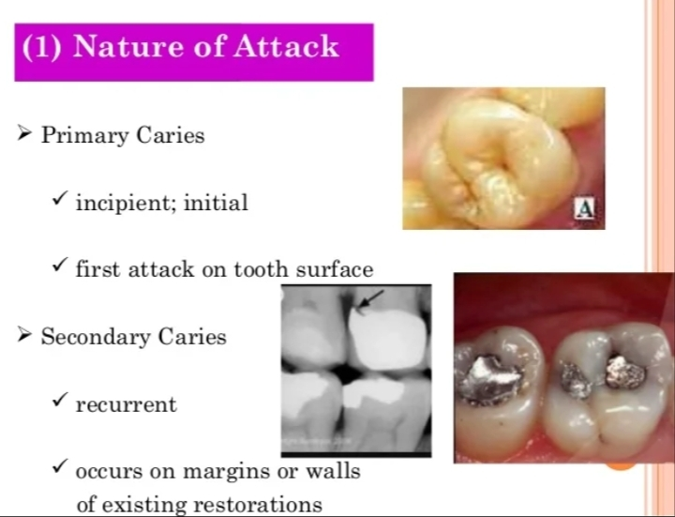

Slide 9
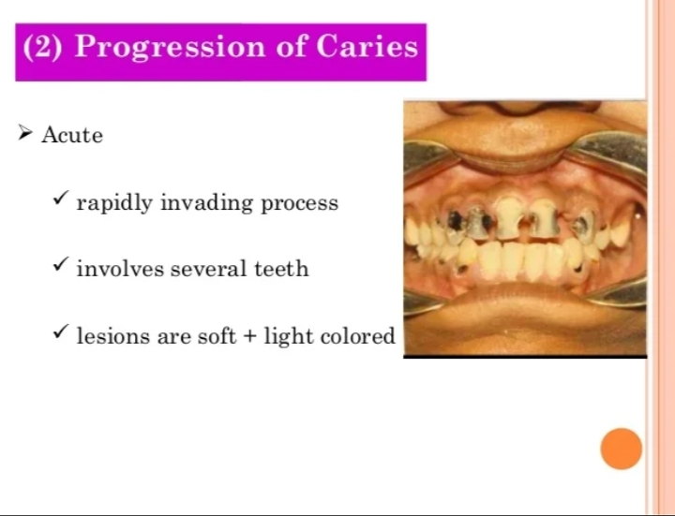

Slide 10
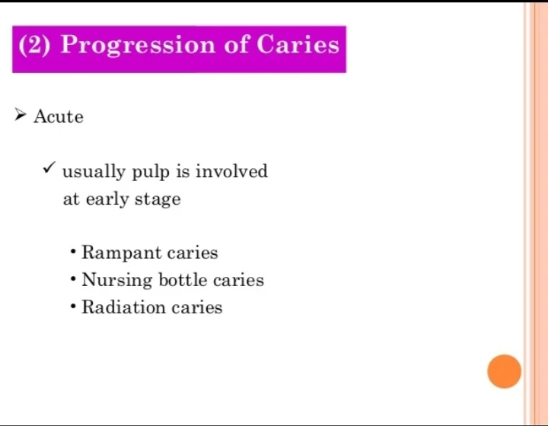

Slide 11
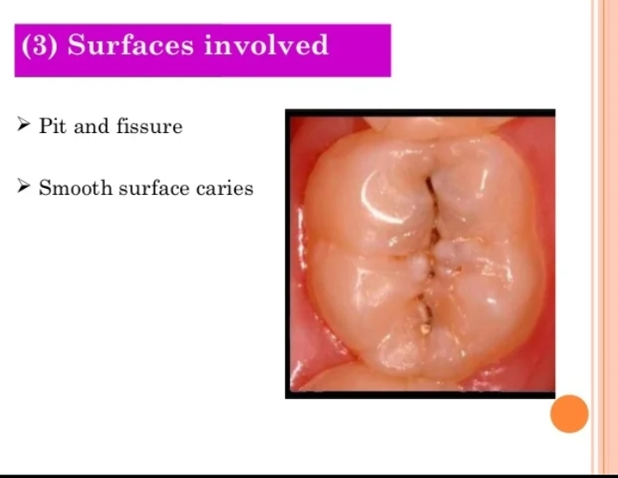

Slide 12
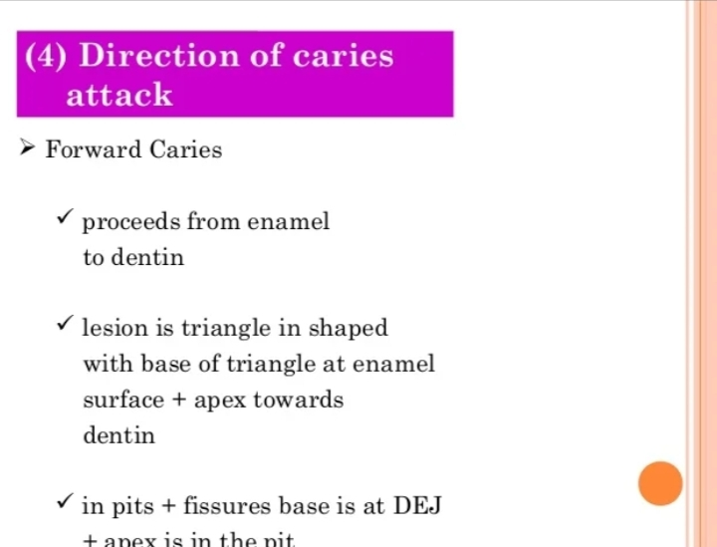

Slide 13
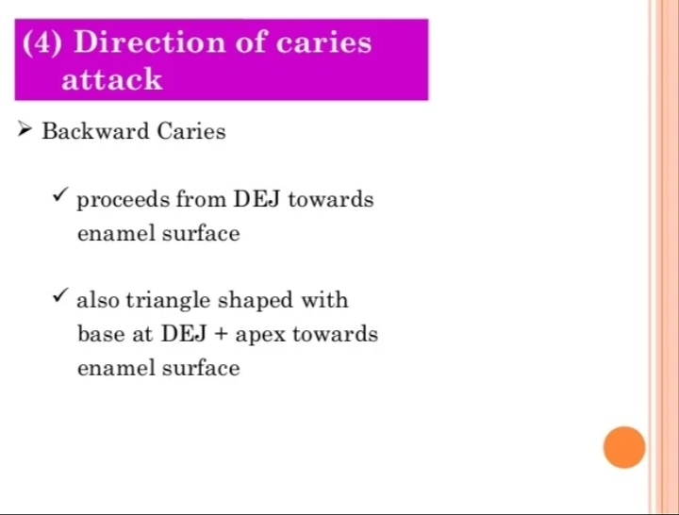

Slide 14
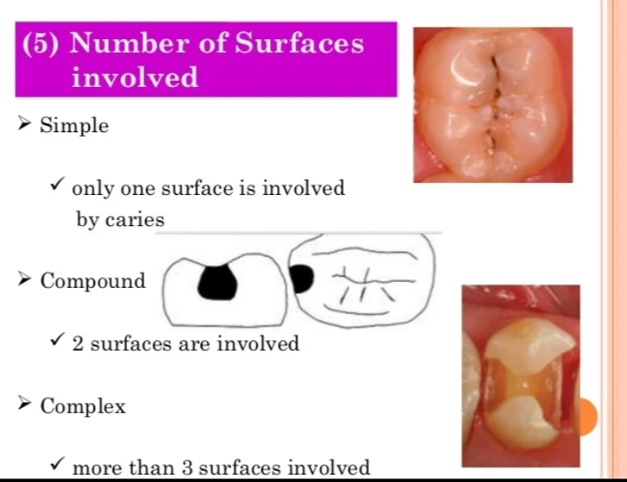

Slide 15
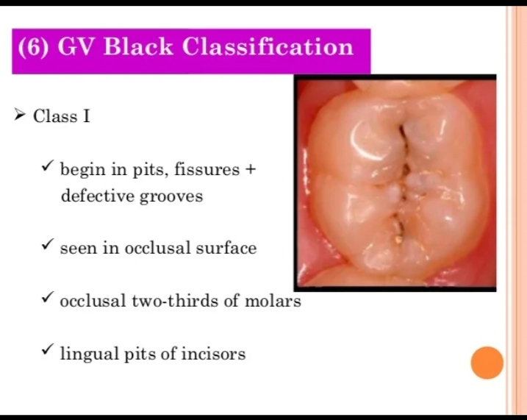

Slide 16
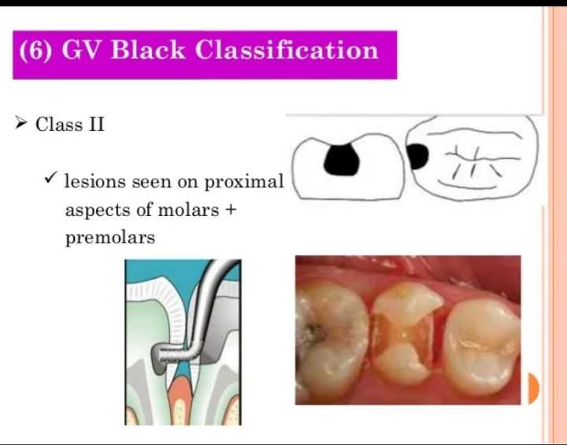

Slide 17
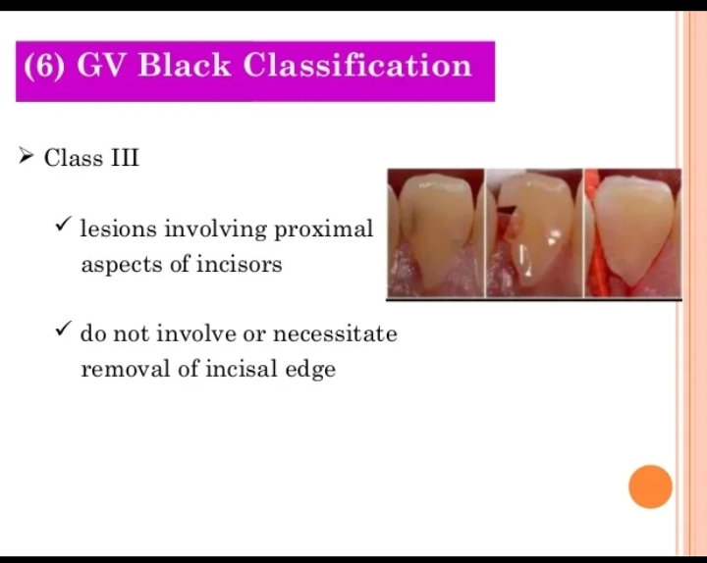

Slide 18
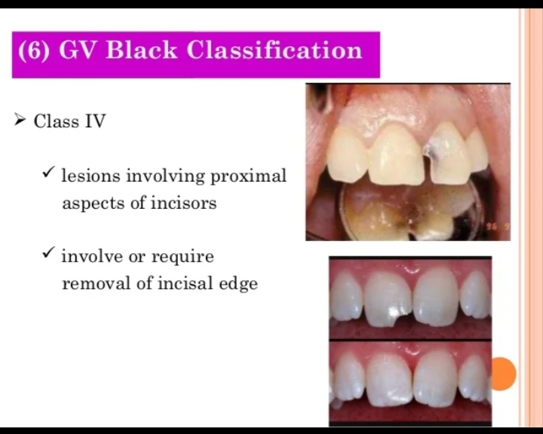

Slide 19
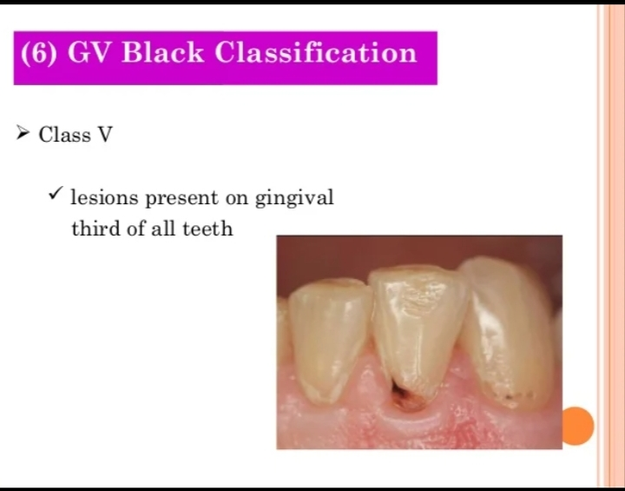

Slide 20
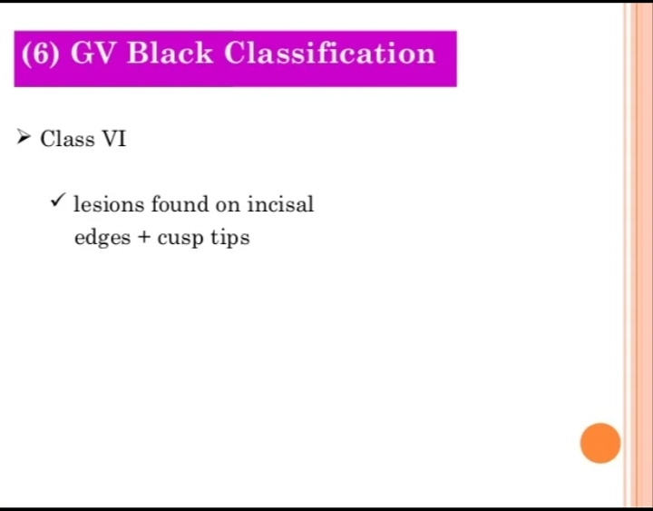

Slide 21
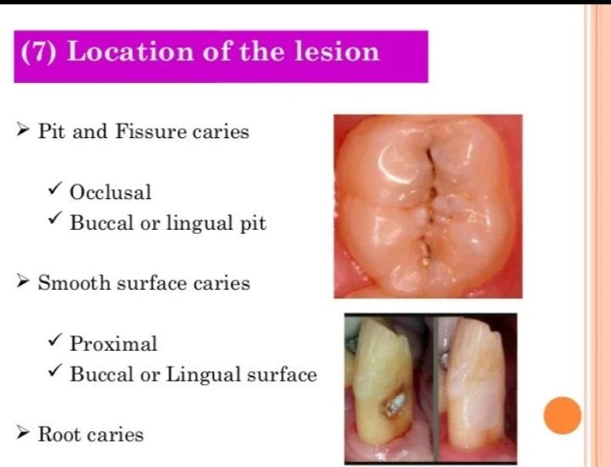

Slide 22
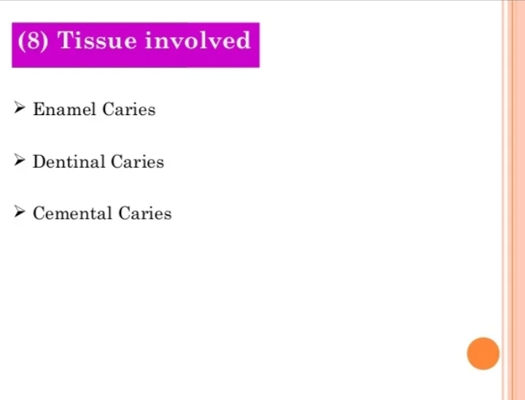

Slide 23
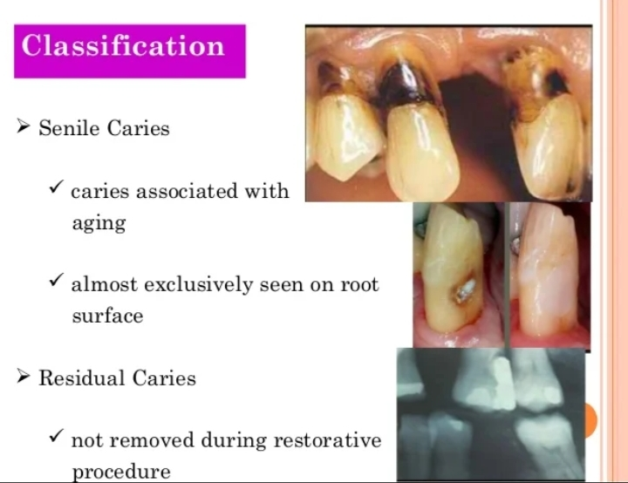

Slide 24
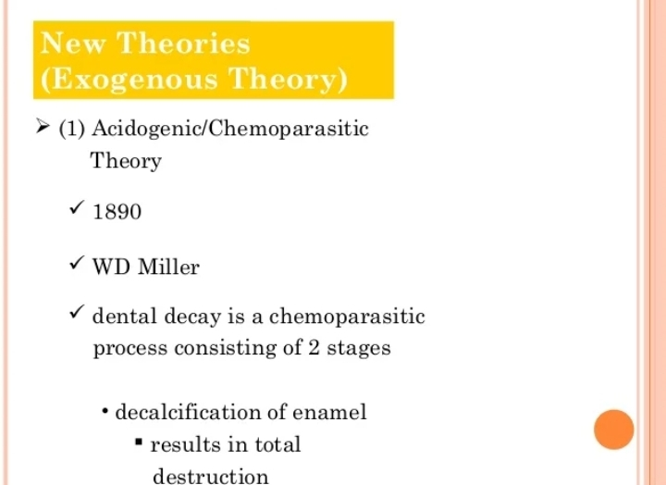

Slide 25
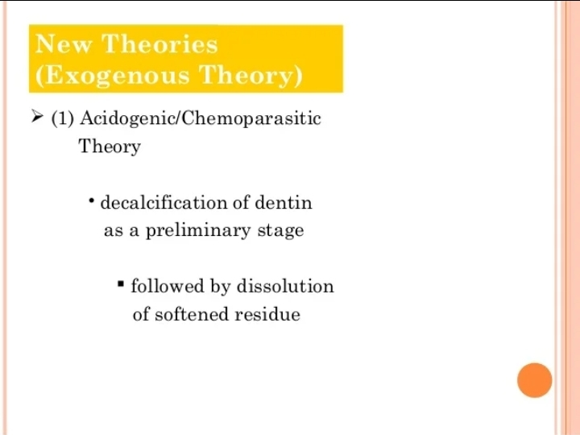

Slide 26
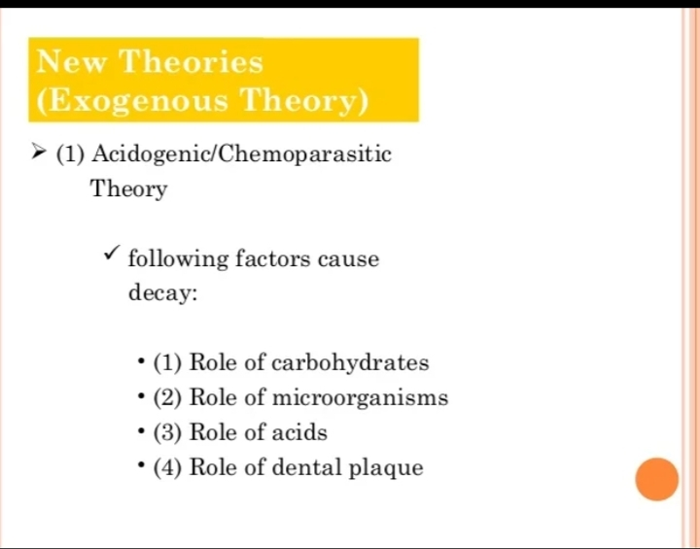

Slide 27
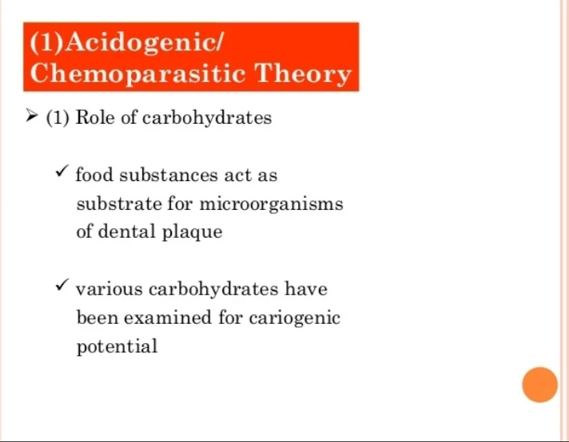

Slide 28
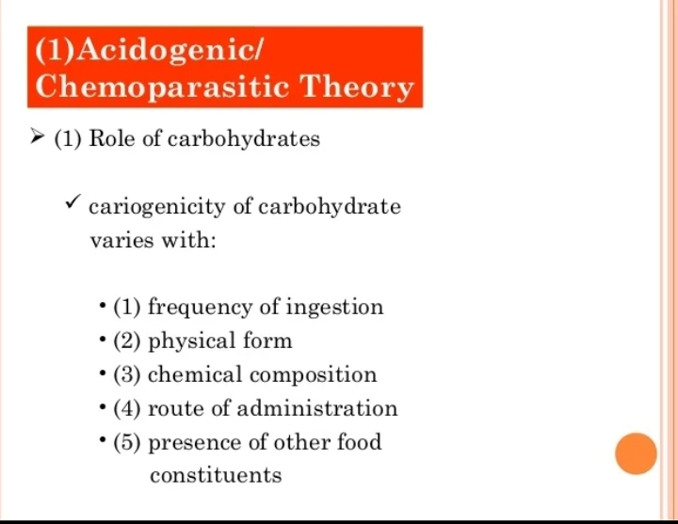

Slide 29
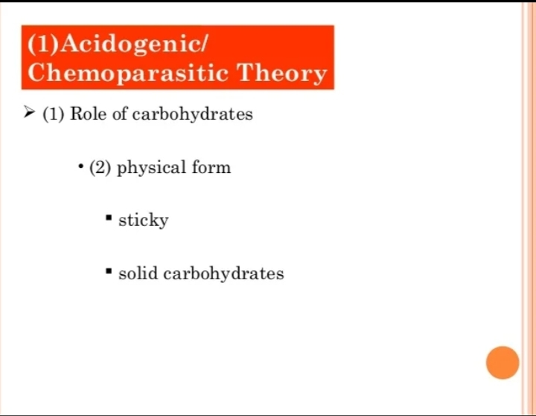

Slide 30
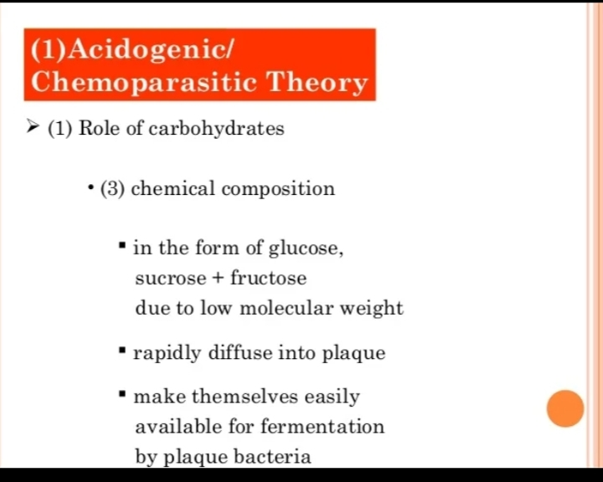

Slide 31
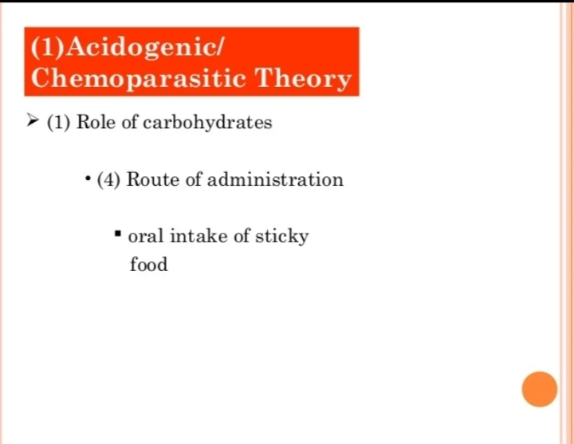

Slide 32
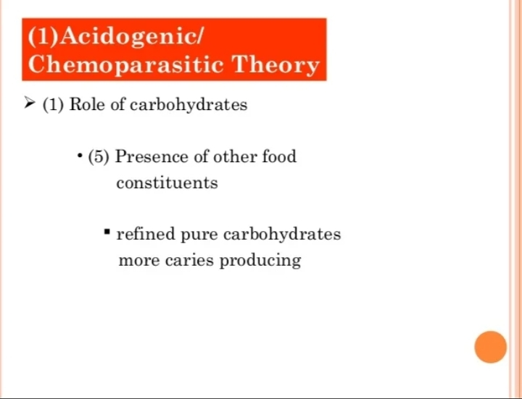

Slide 33
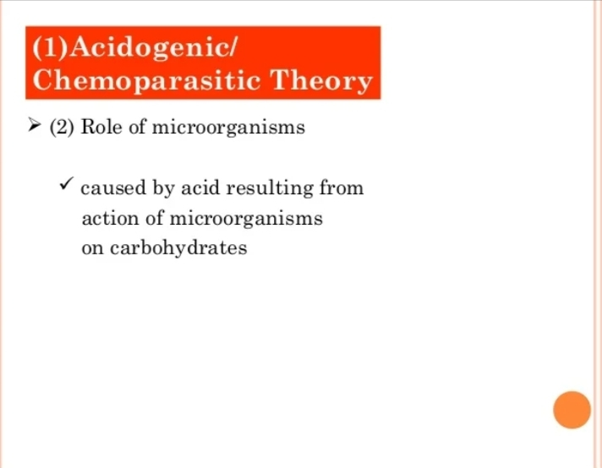

Slide 34
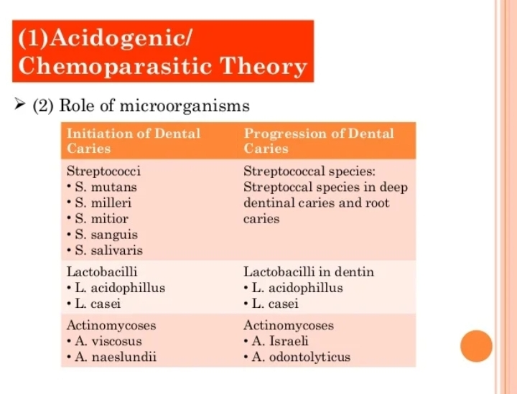

Slide 35
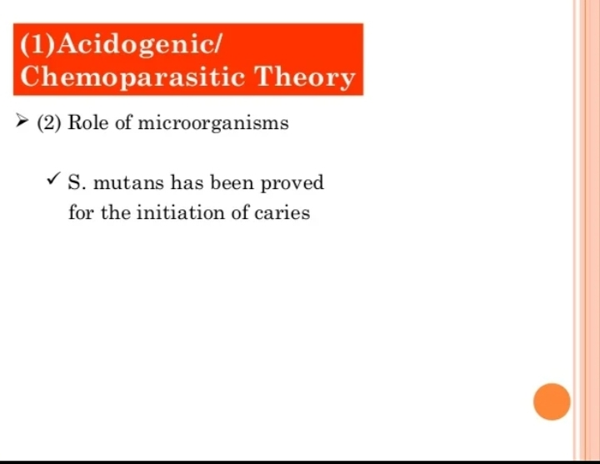

Slide 36
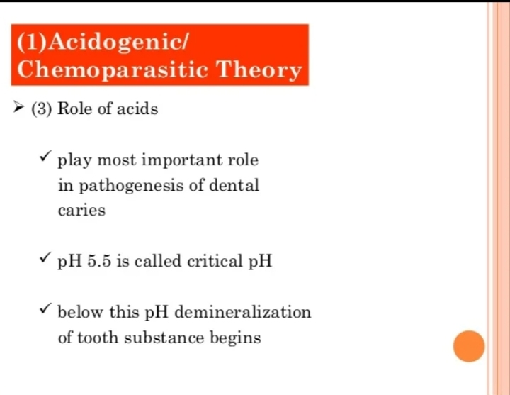

Slide 37
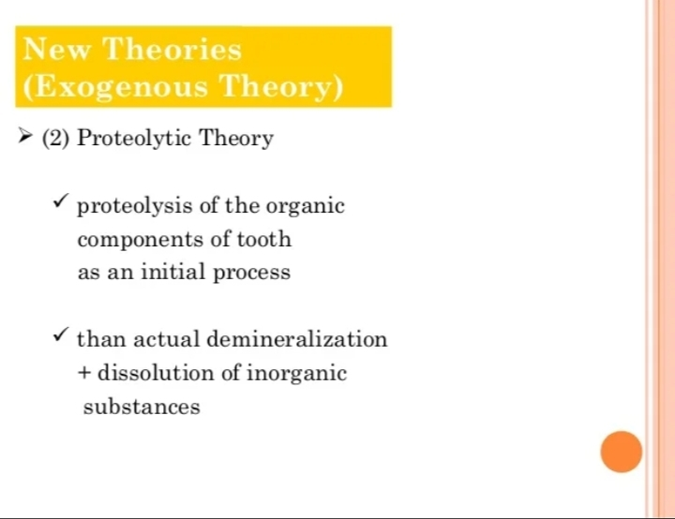

Slide 38
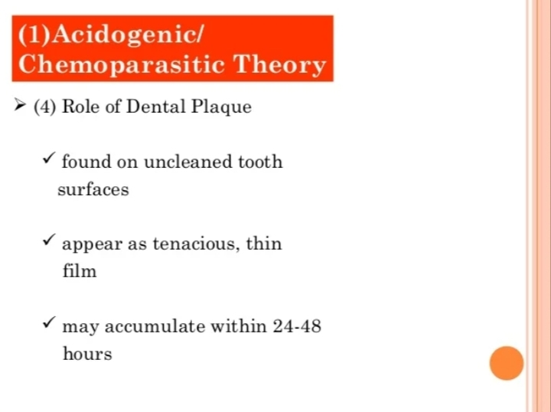

Slide 39
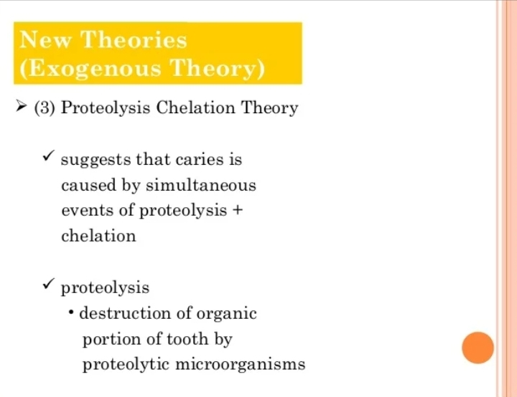

Slide 40
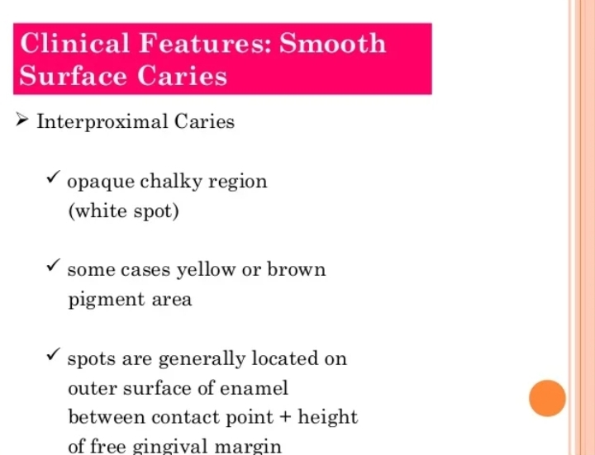

Slide 41
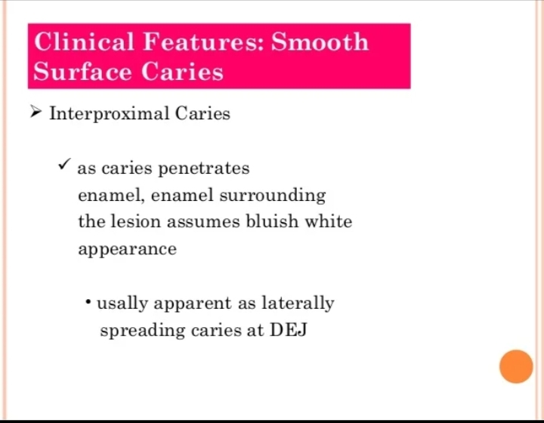

Slide 42
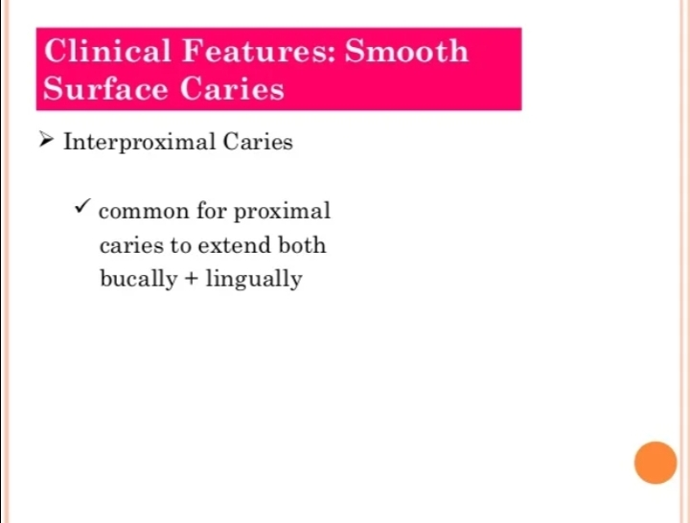

Slide 43
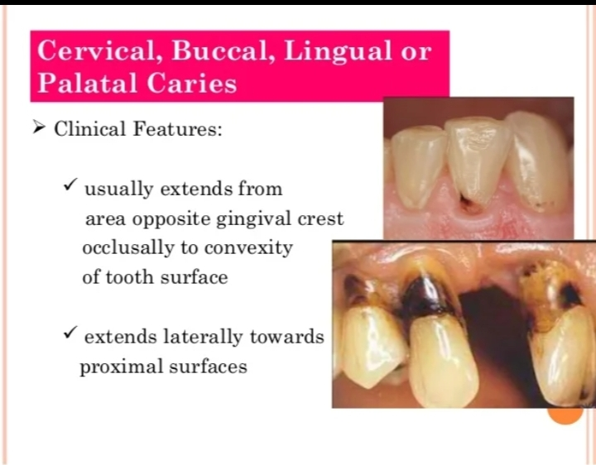

Slide 44
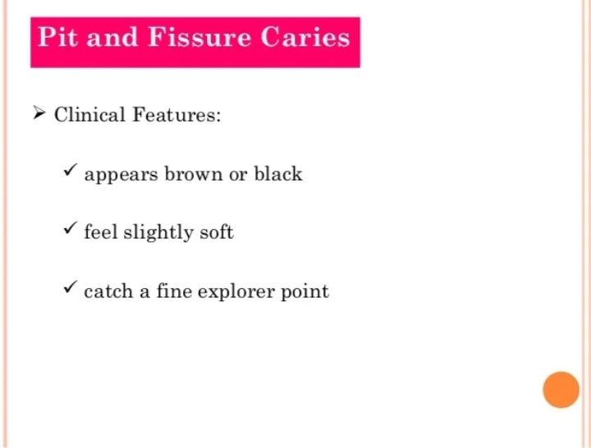

Slide 45
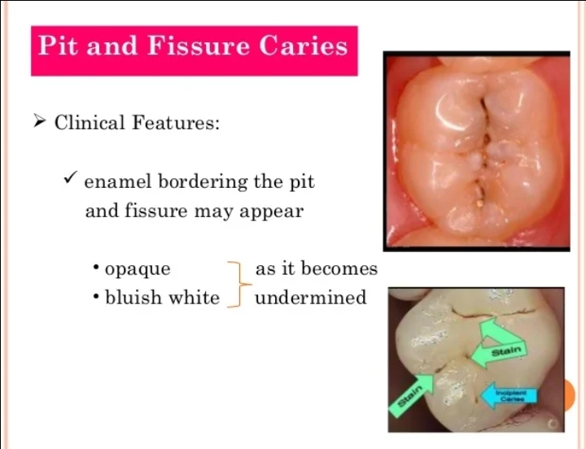

Slide 46
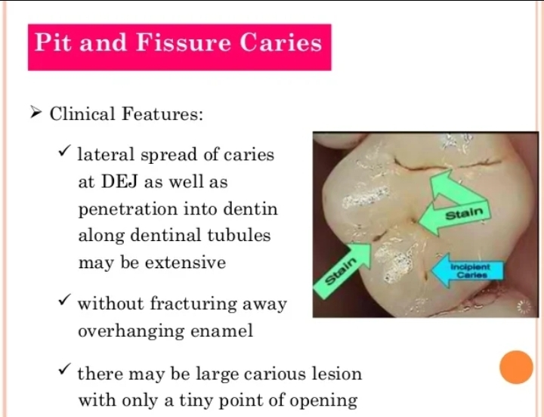

Slide 47
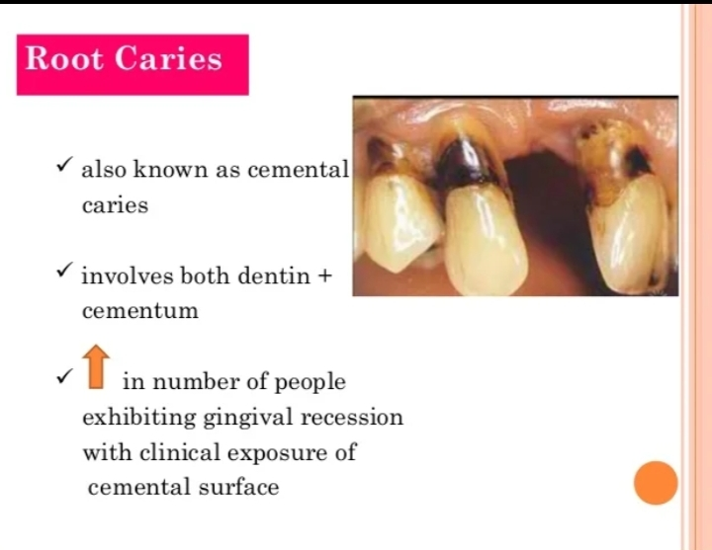

Slide 48
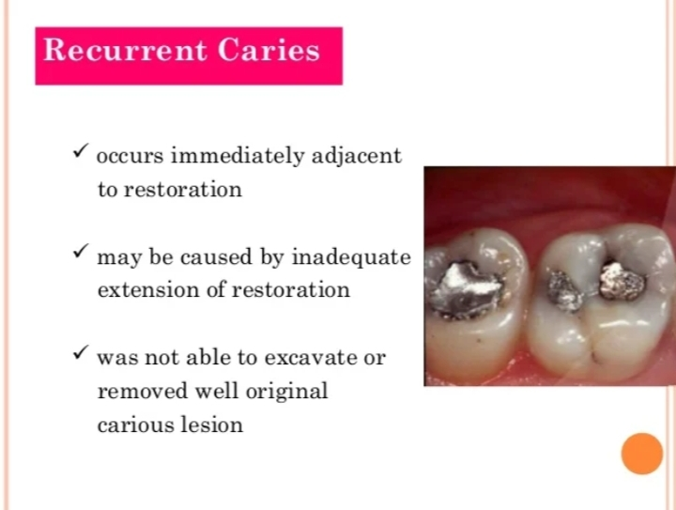

Slide 49
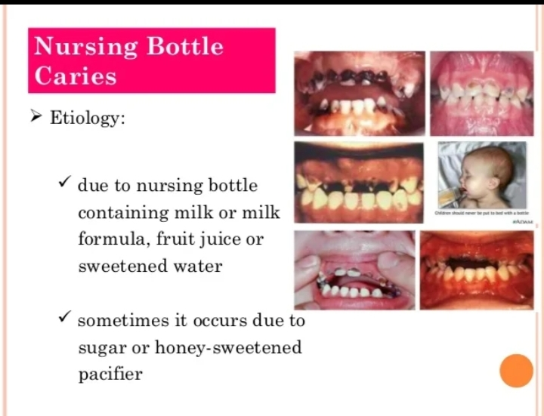

Slide 50
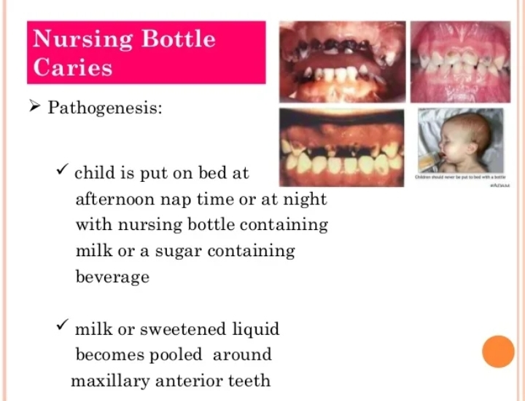

Slide 51
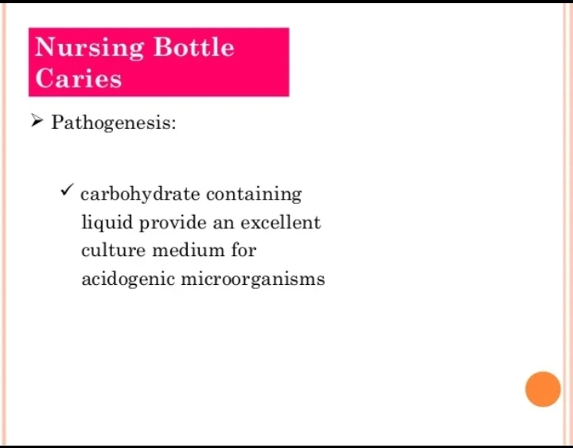

Slide 52
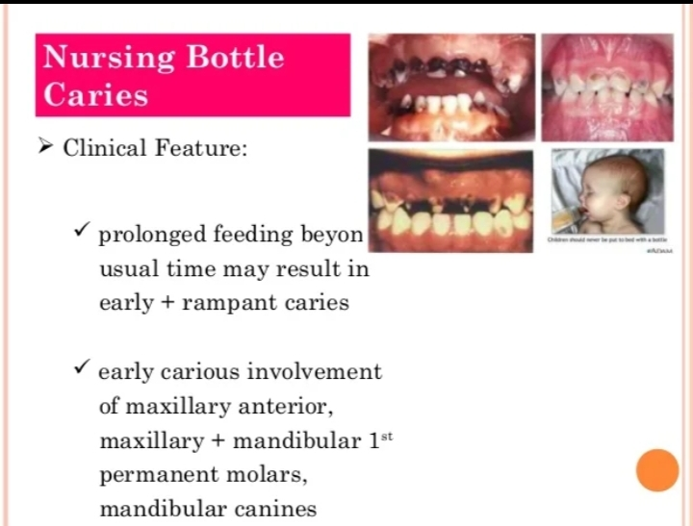

Slide 53
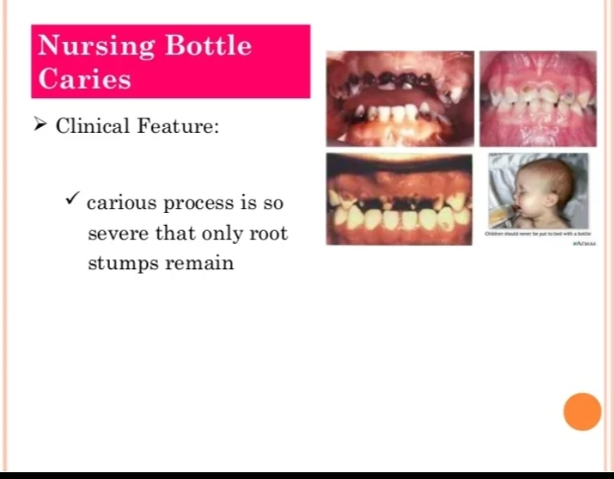

Slide 54
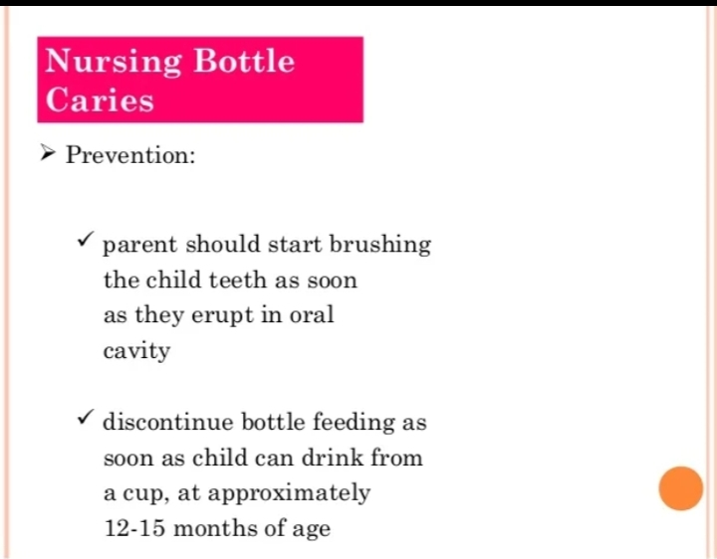

Slide 55
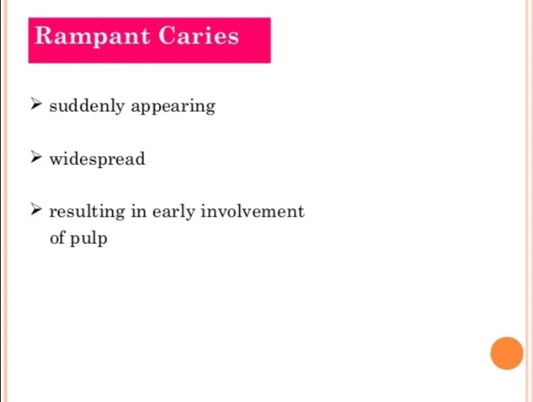

Slide 56


Slide 57


Slide 58


Slide 59

FACTORS AFFECTING DENTAL CARIES

Slide 60


Slide 61


Slide 62


Slide 63


Slide 64
Take home message
Dental caries has a multi factorial causation
Dental caries is an oral infection
Dental caries is a dynamic process
Dental caries can be modified by protective factors

Slide 65
Question & Answer Session
DEFINE DENTAL CARIES & WRITE ABOUT SMOOTH SURFACE CARIES
ZONES OF BACTERIAL INFECTIONS
WRITE ABOUT THEORIES OF DENTAL CARIES

Slide 66
REFERENCES NAME OF THE BOOK WITH EDITION AND PAGE NUMBERS ARTICLE ARE TO BE MENTIONED IF NEEDED
SHAFER’S 9th EDITION
LUCAS
NEVILLE
REGEZI

Slide 67
THANK YOU

